Slide 1
The Fairy Tale
English 7

Slide 2
KWL
K – what do we know
W – what do we want to know
L - what have we learned

Slide 3
Fairy tales you may know
The Princess and the Pea
Beauty and the Beast
Alice in Wonderland
The Three Little Pigs
Snow White
Pinocchio
Cinderella

Slide 4
Collections
Aesop (Fables)
Hans Christian Andersen (Fairy Tales- Danemark)
Jacob and Wilhelm Grimm (Fairy Tales - Germany)
Charles Perrault (Fairy Tales)- France)
Lewis Carroll- England
Carlo Collodi- Italy
Mother Goose (Rhymes)

Slide 5
Where do fairy tales come from?
What is their origin?

Slide 6
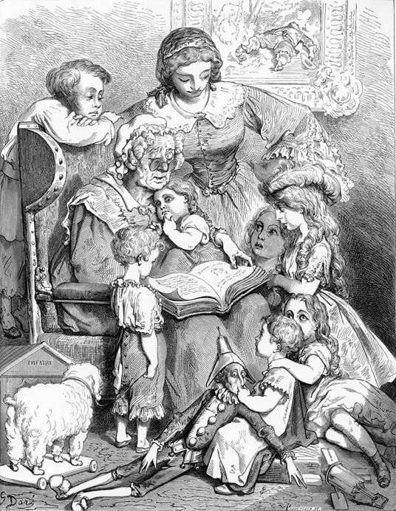

Slide 7
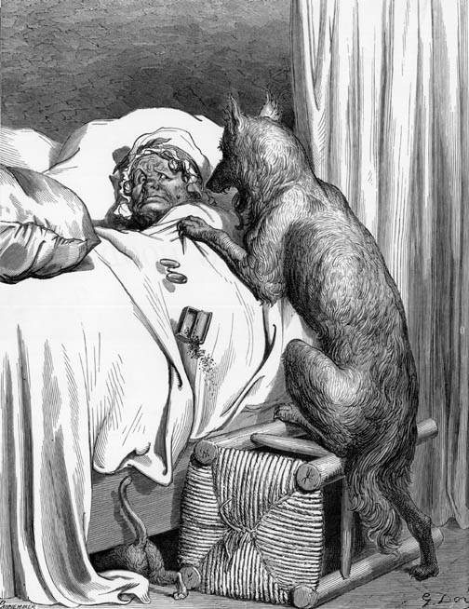
Little Red Riding Hood

Slide 8
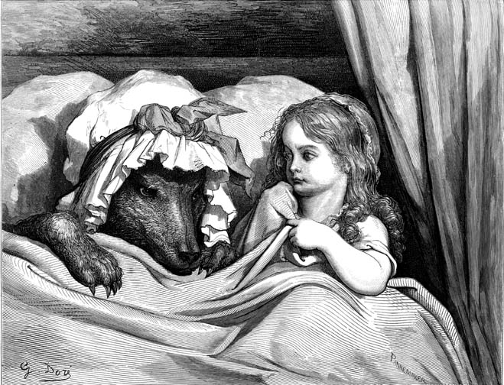

Slide 9
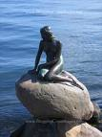

Slide 10
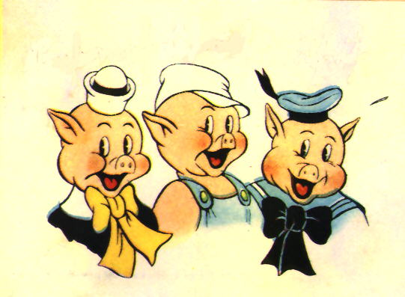

Slide 11
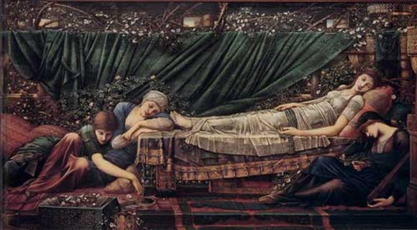

Slide 12
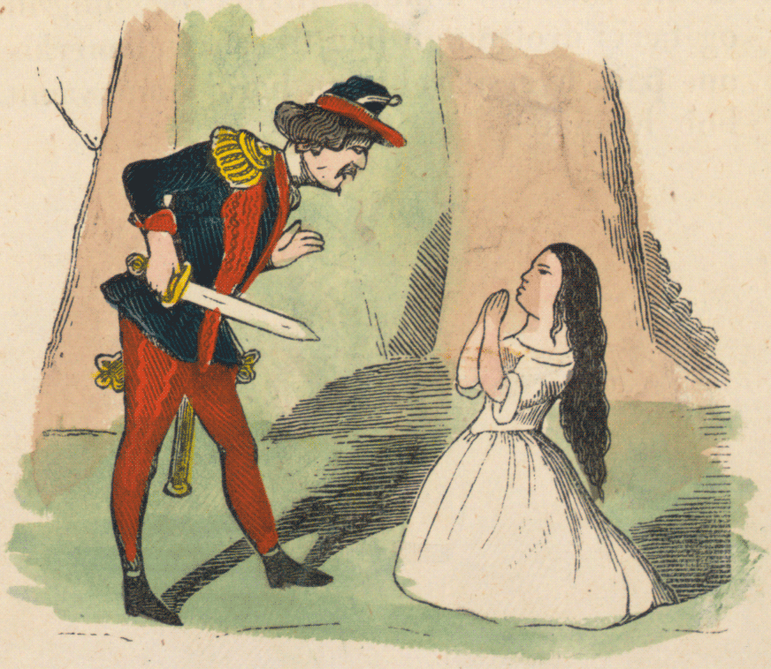

Slide 13
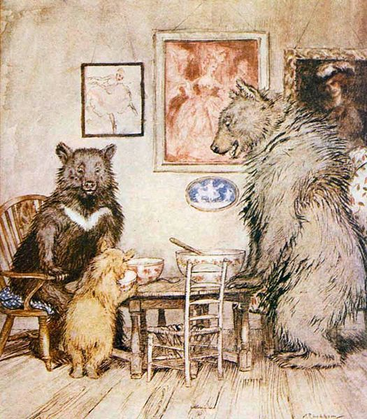

Slide 14
W
What do you want to learn about fairy tales?
Analyze…

Slide 15
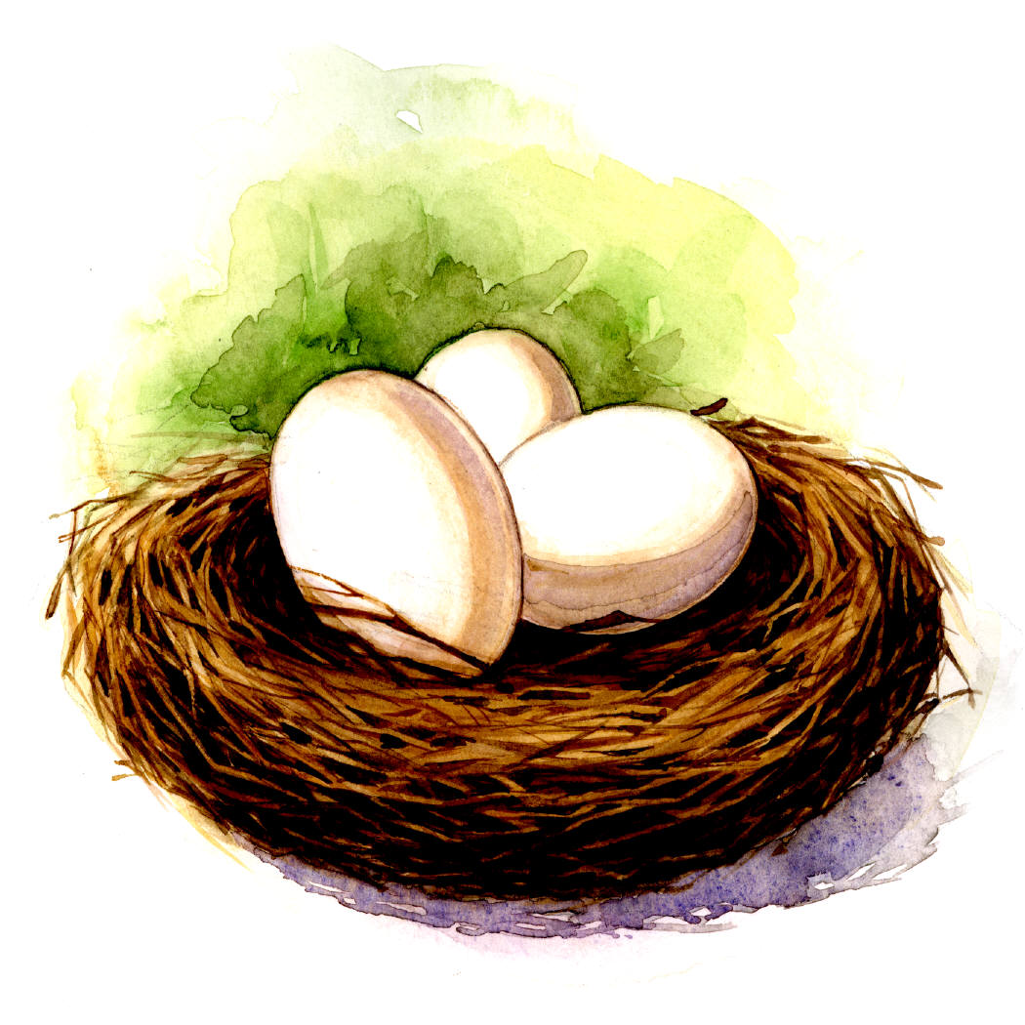

Symbolism
Wolf | egoist, strength, male, persuade
Clouds | confusion, sadness
Gold | perfection
Egg | origin of life
Apple | immortality
Bridge (rainbow) | passage from one state to another, height
Red rose | love, desire, passion
Red | Passion, sexuality

Slide 16
Little Red Riding Hood
Red Cape
Red Lips
Red Moon
Blood on Snow

Slide 17

Sword | masculinity
Blood | life-death, puberty
Tree | Intermediate between two Worlds
Animals | instinct, reproduction, agressivity
Silver | purity
White | innocence, purity, naive, childhood
Horse | vital energy
Fur-Hair | animal nature, physical force, vitality
Crown | power, control, master or leader

Slide 18
Flower | femininity
Forest | mystery, unknown
Gun | Power, fear
Cake (cookies etc.) | please by taste, temptation
Garden | paradise
Games | childhood, end of childhood
Moon | Lunar cycle, change from day to night, girl to woman, man to wolf
Mirror | Illusions
Black | negative, bad, ignorance, dishonesty
3, 7, 9 | Total being, harmony, perfection

Slide 19
L
We will discuss what we have learned at the end of the unit ☺

